Slide 1




AI-Mitigated Child Health
Predictive Analytics & Intervention Framework for Urban Pollution and Pediatric Health Risks
Team Members:
Dr R Praveen Kumar [TL]
Shaik Abdul Razak
Kasula Shiva Kumar
Ganireddy Umesh
Rajesh Potharla
Affiliation:
Chaitanya Deemed to be University
Himayathnagar
Hyderabad
500075 - Telangana

Slide 2
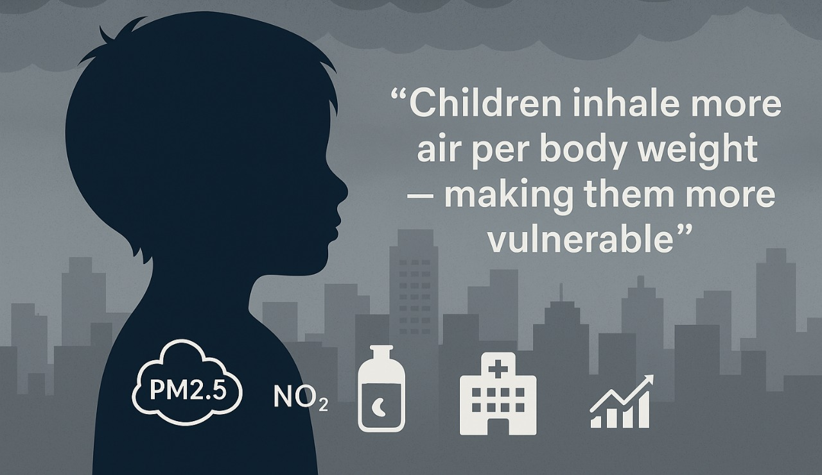

“The Growing Threat:
Urban pollution & child Health “
Lists like this one:-
90% of children breathe air exceeding WHO pollution limits
Rising pediatric respiratory infections in urban areas
Lack of real-time preventive systems — existing models are reactive
Need for AI-driven prediction and intervention framework

Slide 3
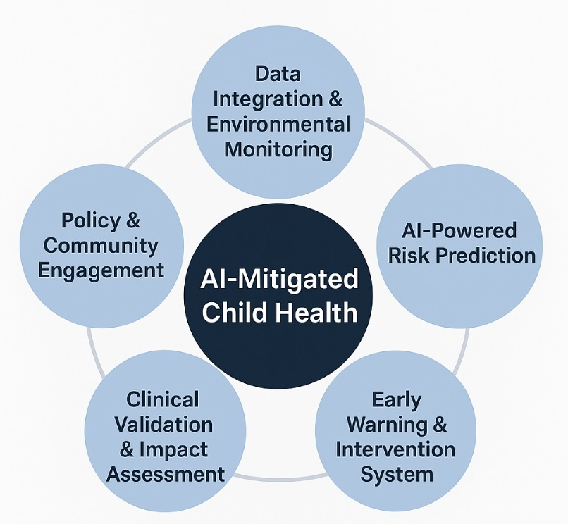



Project Vision & Strategic Objectives
Data Integration & Environmental Monitoring
AI-Powered Risk Prediction
Early Warning & Intervention System
Clinical Validation & Impact Assessment
Policy & Community Engagement

Slide 4

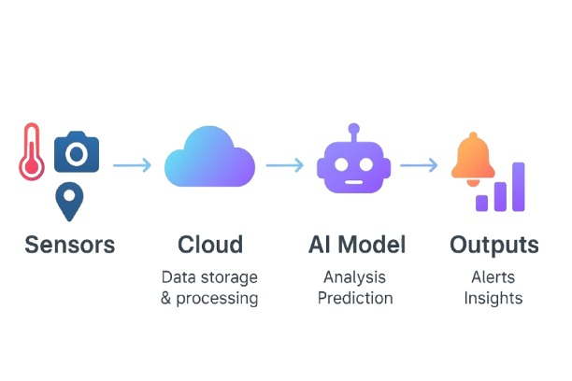
Integrated Data & AI Architecture
01
02
Data Sources
Pipeline
03
Architecture Layers:
IoT sensors (air quality), public datasets, pediatric health records
Real-time ingestion → Cloud processing → AI model → Alerts & dashboards
Data Layer: Air quality, health, geospatial
Model Layer: ML/DL ensemble (LSTM + XGBoost + Transformer)
Application Layer: Mobile app, healthcare dashboards, APIs

Slide 5
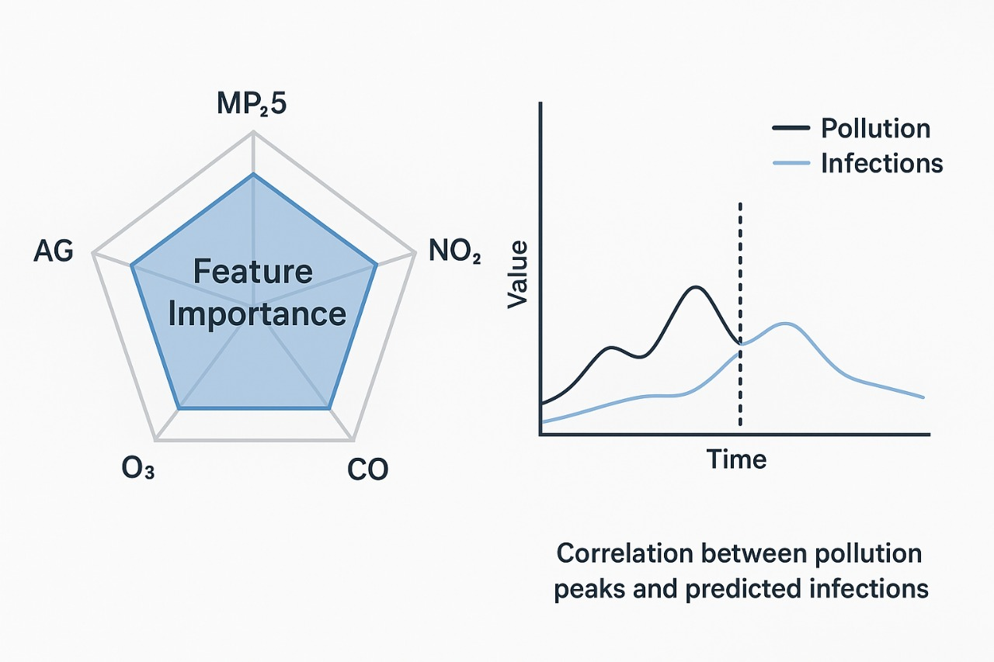
AI-Powered Predictive Analytics for Pediatric Health
Model Innovations: | Hybrid H²MCM (Health–Hazard Multi-Correlation Model) Transformer-based attention for dynamic feature importance Ensemble model combining LSTM (temporal) + XGBoost (tabular) + Neural Nets (personal health data)
Outputs: | Personalized risk scores Spatiotemporal hotspot forecasting Pollution-health correlation heatmaps
KPIs: | Prediction Accuracy > 85% Forecast horizon: 24–48 hours

Slide 6
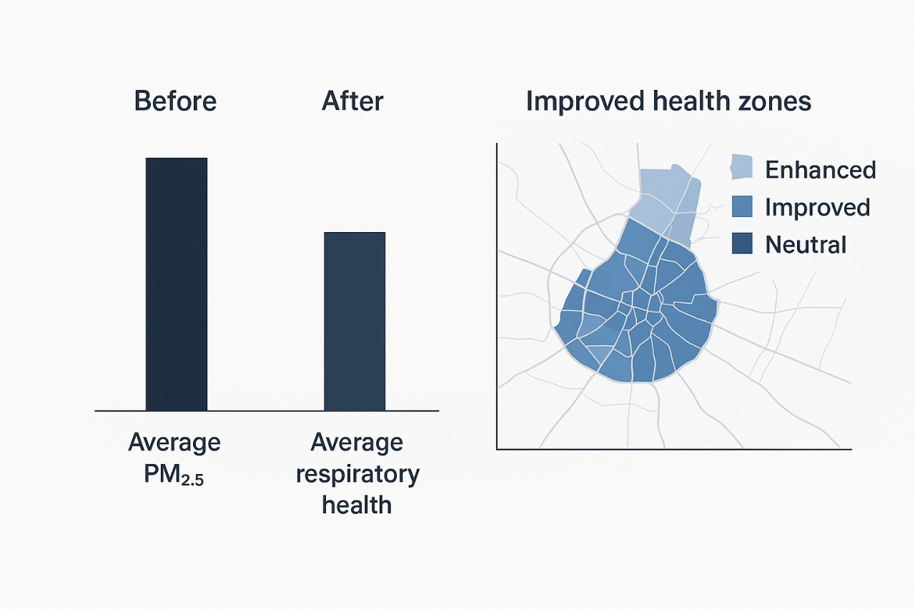
Turning Predictions into Protection
System Features:
Stakeholders
Real-time alerts to parents/schools (<5 min latency)
Mobile app for personalized recommendations (e.g., mask alerts, indoor playtime)
Automated preventive notifications
Children & Parents
Schools
Pediatricians
Urban planners

Slide 7
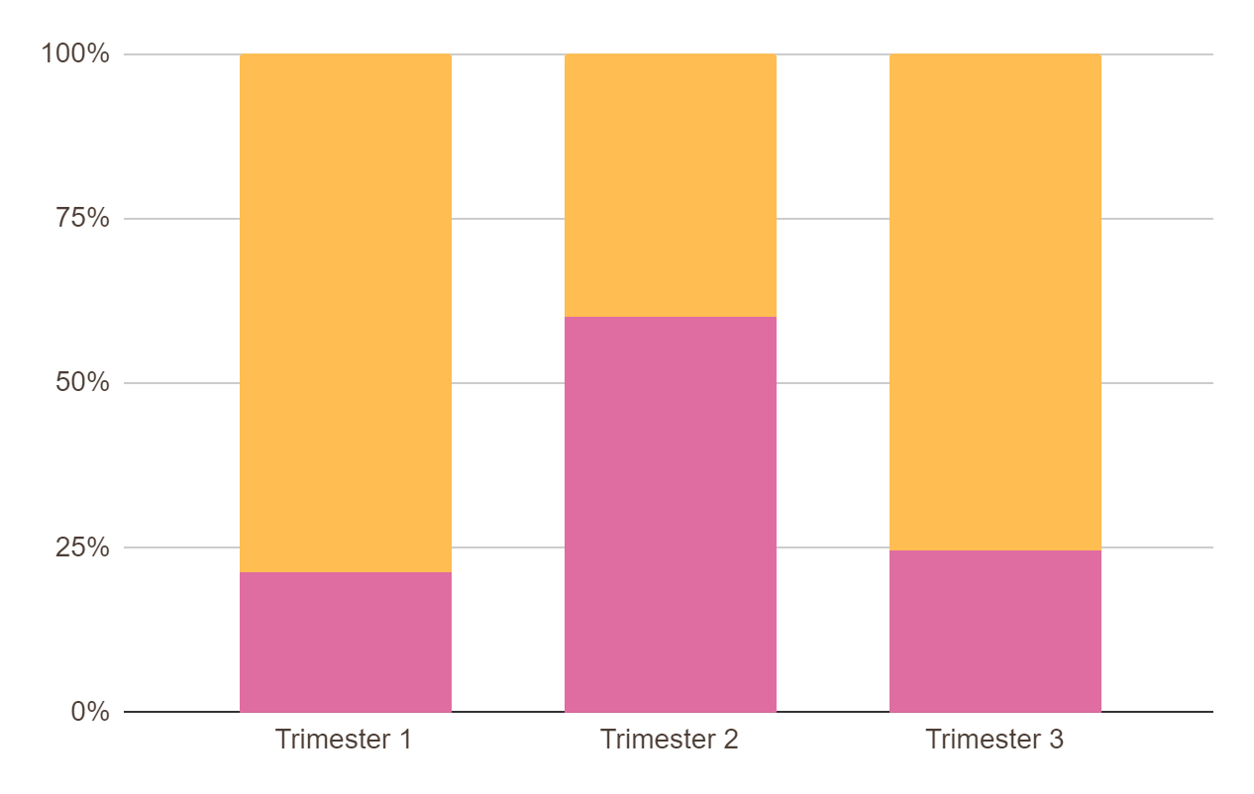
Clinical Validation & Measurable Impact
Step 1
Validation Plan
Longitudinal study (1000+ children, 1–2 years)
Comparison of predicted vs actual respiratory events
30% reduction in respiratory infections
25–40% fewer hospital visits
99.5% system reliability
Step 2
Expected Outcomes
Step 3
Impact Metrics
Policy
recommendations
produced
Health
improvement
Papers published
/ datasets released

Slide 8


Scaling for Sustainable Urban Health Futures
Category | Description
Policy Integration | Data-driven urban planning insights School air-quality management protocols Evidence-based recommendations for local governments
Future Outlook | National-level scale-up Integration with WHO’s Urban Health Index Community awareness ecosystem
Closing Message | “AI isn’t just predicting illness — it’s preventing it.”

Slide 9

The Core Challenge:
Building a Sustainable India
Main Target :-
To develop smarter, greener, and more resilient cities and villages across India.
We must solve:
Unplanned growth causing pollution and overcrowding.
Lack of green spaces making areas hotter and less healthy.
Poor resource management leading to water and energy waste.
Vulnerability to climate change in both urban and rural areas.
The ultimate goal is to create communities that are sustainable, healthy, and prepared for the future.

Slide 10
Thank You

